Slide 1
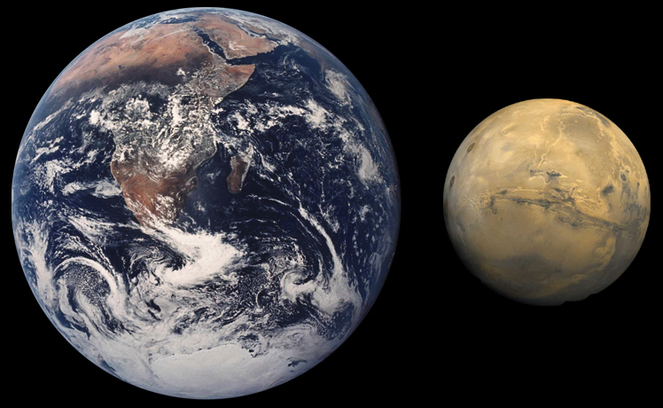
Insights from Mars and Earth for Predictability and Ensemble Kalman Filtering
Steven J. Greybush
Penn State University
Collaborators:
EnKF: Yongjing Zhao, Eugenia Kalnay, Takemasa Miyoshi, Kayo Ide, Stephen Penny, Weather Chaos Group
Mars: John Wilson, Matt Hoffman, Ross Hoffman, Tim McConnochie, NASA, Luca Montabone, Thomas Navarro, MCS Team
Lake Effect: George Young, Daniel Eipper, Christopher Melhouser, Yonghui Weng, Fuqing Zhang, OWLeS Team

Slide 2
Comparing the Earth and Mars
Variable | Earth | Mars
Radius | 6378 km | 3396 km
Gravity | 9.81m s⁻² | 3.72m s⁻²
Solar Day | 24 hours | 24 hours 39 minutes
Year | 365.24 earth days | 686.98 earth days
Obliquity (Axial Tilt) | 23.5 deg | 25 deg
Primary Atmospheric Constituent | Nitrogen and Oxygen | Carbon Dioxide
Surface Pressure | 101,300 Pa | 600 Pa
Deformation Radius | 1100 km | 920 km
Surface Temperature | 230-315 K | 140-300 K
Table Courtesy of Matthew Hoffman and John Wilson

Slide 3
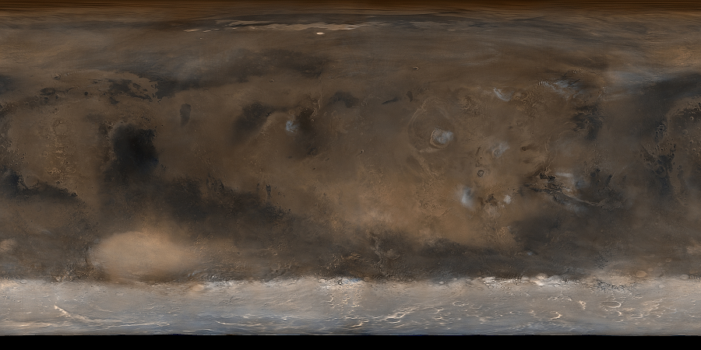
Features of Martian Weather
Figure Courtesy of NASA/JPL and Malin Space Science
Traveling Weather Systems
Diurnal Cycle, Thermal Tides, Topography
Seasonal CO₂ Polar Ice Caps
Water Ice Clouds
Dust Devils, Regional and Global Storms
Olympus Mons
Water Ice Clouds
Hellas Basin
Seasonal CO₂ Polar Ice Cap
MGS Mars Orbital Camera (MOC) Visible Image
Notes:
Are those clouds associated with orography?

Slide 4
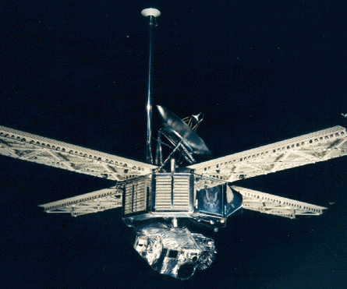
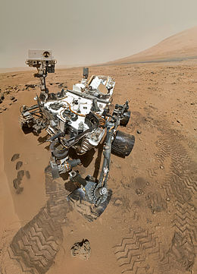
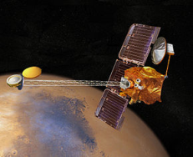
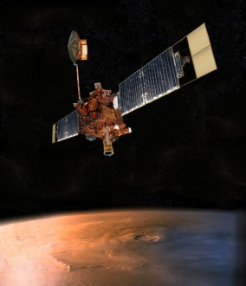
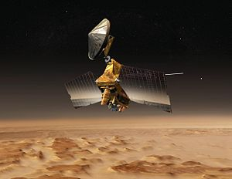
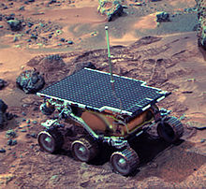
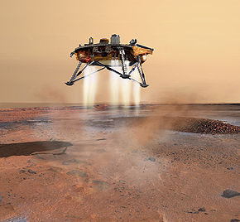
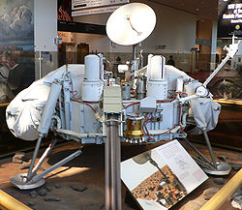
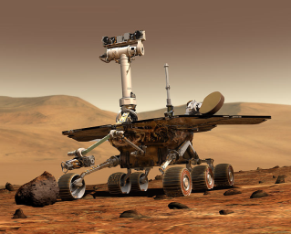
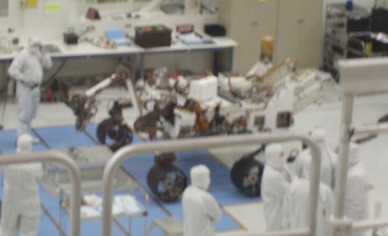
Spacecraft Exploration of Mars
Mars Global Surveyor: TES, MOC, MOLA…
Mars Reconnaissance Orbiter:
MCS, MARCI…
Mariner Program: Observed Dust Storms
Mars Odyssey: Imaging and Spectrometry
Mars Science Laboratory (MSL)
Curiosity rover
Launched Nov. 2011, Arrived on Mars Aug. 2012
Rover Environmental Monitoring Station (REMS) – Air and Ground Temperature, Winds, Surface Pressure, Relative Humidity, UV Radiation
1960
1970
1980
1990
2000
2010
2015
Viking Lander: Surface Pressure Time Series
Images Courtesy of Wikipedia
Mars Exploration Rovers: Dust Devils
Mars Pathfinder: Surface Weather
Mars Phoenix Lander: Precipitation, Water Ice

Slide 5
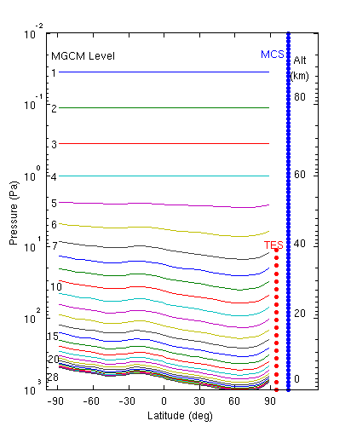
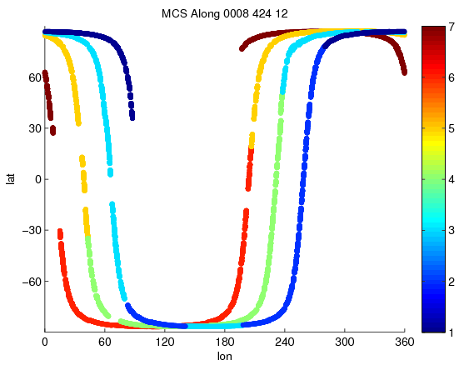
EMARS: Ensemble Mars Atmosphere Reanalysis System
Spacecraft Observations:
TES (Thermal Emission Spectrometer)
and MCS (Mars Climate Sounder)
temperature and aerosol retrievals.
For assimilation, create superobservations.
See poster for improved retrieval assimilation strategy
that removes influence of prior and error correlations.
Spacecraft Horizontal Coverage in 6hrs
Spacecraft and Model Vertical Coverage

Slide 6
EMARS: Ensemble Mars Atmosphere Reanalysis System
Spacecraft Observations:
TES (Thermal Emission Spectrometer)
and MCS (Mars Climate Sounder)
temperature and aerosol retrievals.
Model:
GFDL Mars Global Climate Model (MGCM).
~300 km horizontal resolution
Assimilation System: 4d-LETKF
Reanalysis Product Contains:
3 Years of TES, 1+ Years of MCS analyses.
Hourly fields of temperature, winds, surface pressure, aerosol.
Atmospheric state and its uncertainty (ensemble means and spread).
Spacecraft and Model Vertical Coverage

Slide 7
Validation Strategy
Comparisons with freely running forecasts.
RMSE and bias of short term forecasts initiated from ensemble analyses.
Comparisons to independent radio science profiles and rover data.
Feature-based evaluation: traveling waves, tides, aerosols.

Slide 8
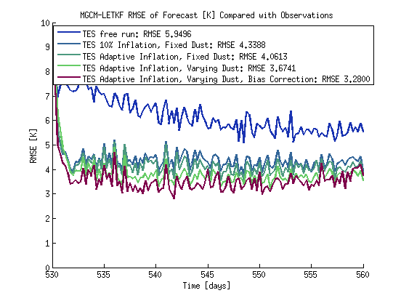
Improving LETKF Performance
Freely Running Model
Initial Assimilation
Adaptive Inflation (Miyoshi 2011)
Varying Dust Distribution
Empirical Bias Correction (Danforth et al., 2007)
Evaluated by comparing 0.25 sol forecasts with observations.

Slide 9
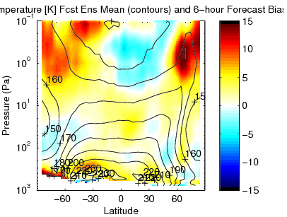
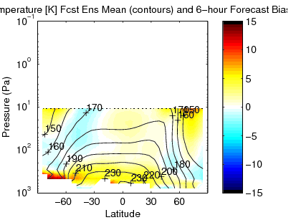
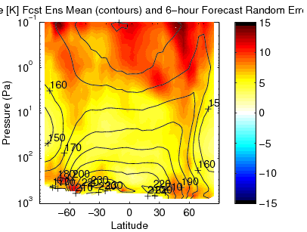
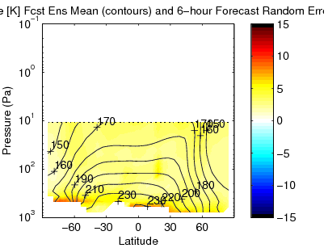
NH Autumn Ls 185-203
MCS
TES
Bias
MCS
TES
Random Error

Slide 10
Impact of Dust Configuration on RMSE

Slide 11
Mars Synoptic Weather Maps: Can we converge upon a synoptic state?
Shading: Temperature Anomalies (2 K intervals);
Contours: Surface Pressure Anomalies; Vectors: Wind Anomalies

Slide 12
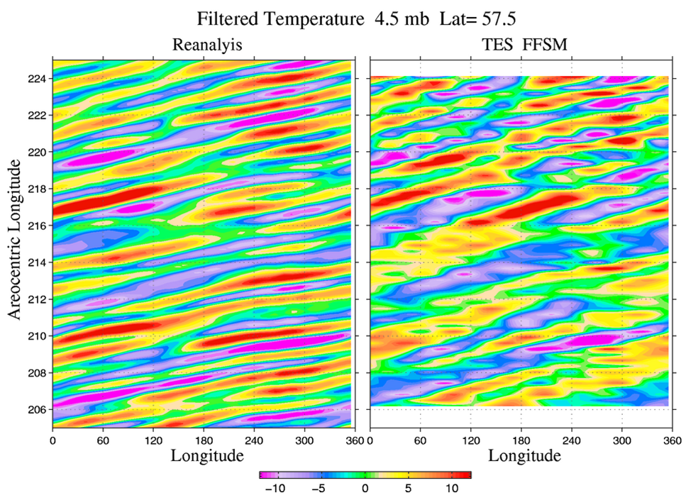
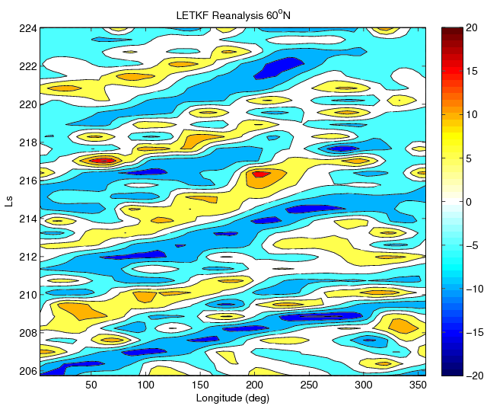
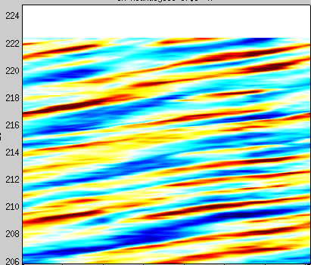
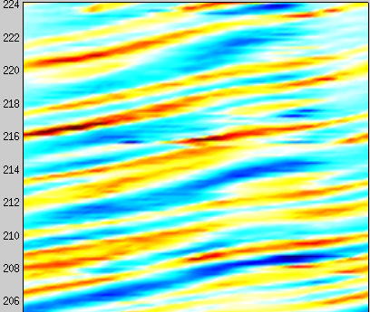
NH Traveling Wave Comparison
*Preliminary*
Limited Duration Comparison
MY 24 Ls 206-224
0.25 sol granularity
MACDA Reanalysis (Plotted SJG)
At 60 S, MGCM Level 20, MCD Dust
EMARS Reanalysis (Plotted SJG)
At 60 S, MGCM Level 20, TES Dust, BC
TES FFSM (Plotted RJW)
Courtesy of Jeff Barnes

Slide 13
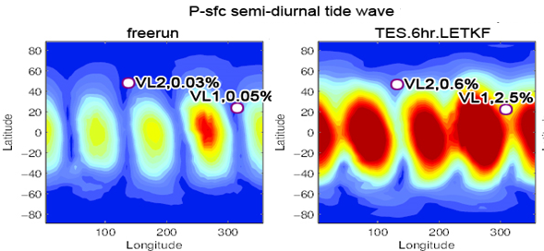
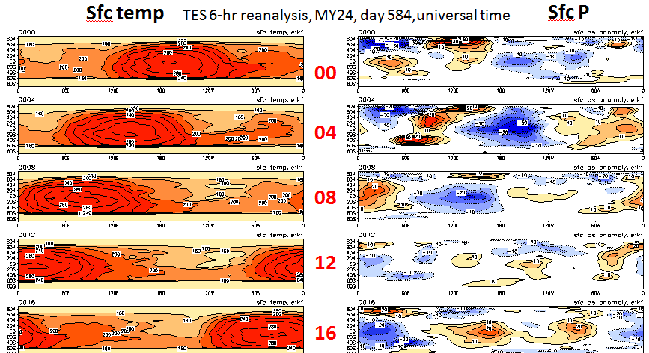
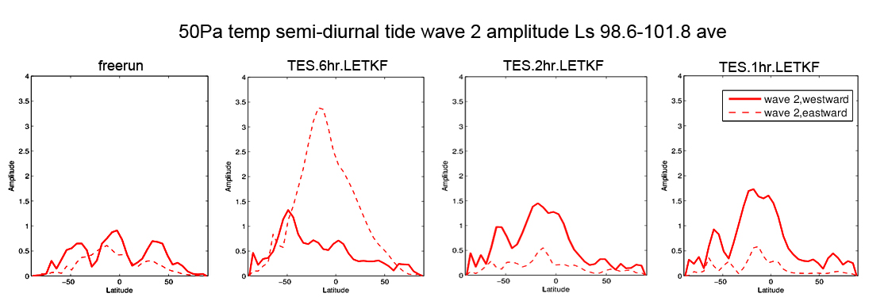
Courtesy of Grad Student Yongjing Zhao
Resonance induced to Semi-Diurnal Tide by 6-hr Data Assimilation Windows

Slide 14
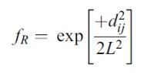
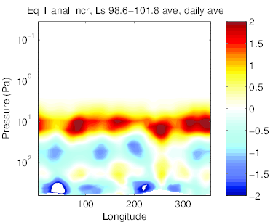
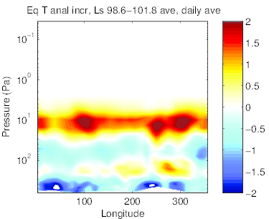
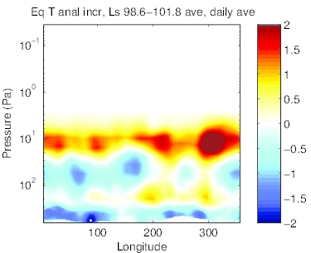
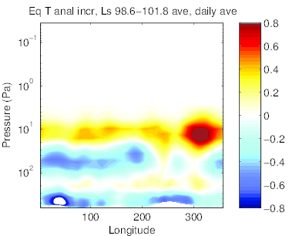
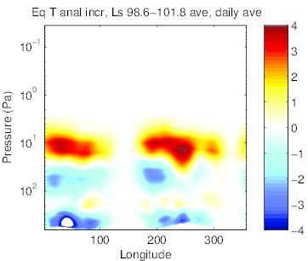
Equatorial daily ave analysis increment, with RAC
6hr, localization radius=600
6hr, localization radius=1200
6hr, DA at hr03,09,15,21
Localization radius = 600
(original)
Courtesy of Grad Student Yongjing Zhao
2hr, localization radius=600
1hr, localization radius=600
12hr, localization radius=600

Slide 15
Courtesy of Grad Student Yongjing Zhao
Resonance induced to Semi-Diurnal Tide by 6-hr Data Assimilation Windows
Wave 4 spatial pattern of observation increments modulates semi-diurnal tidal modes through constructive interference.
(On Mars, topography also modulates the tides.)
Solution:
Use shorter assimilation window (1 or 2 hours)

Slide 16
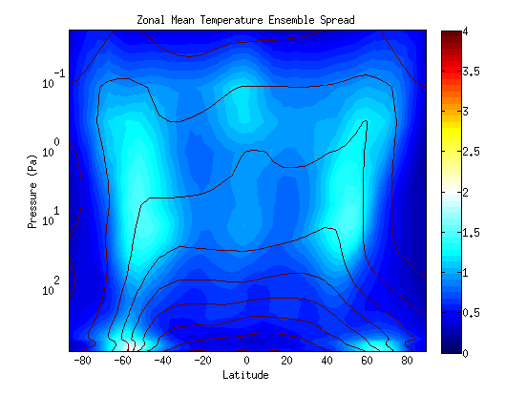
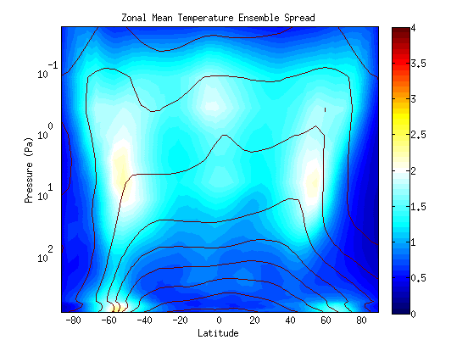
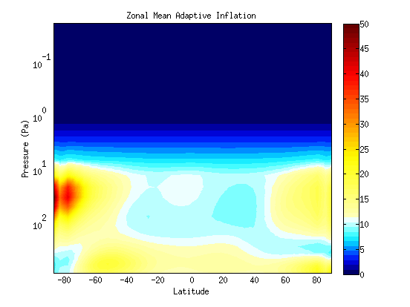
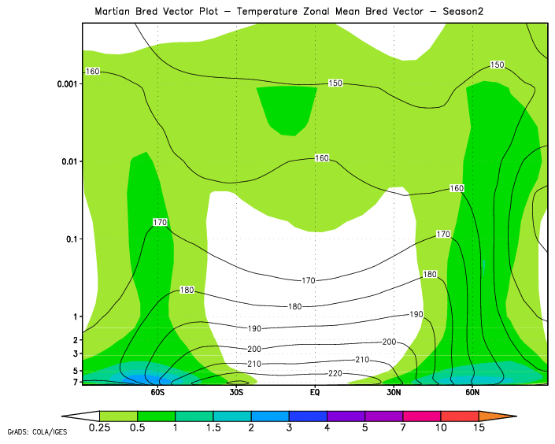
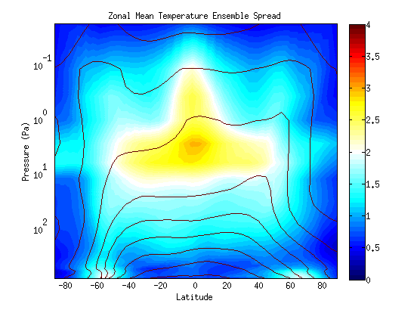
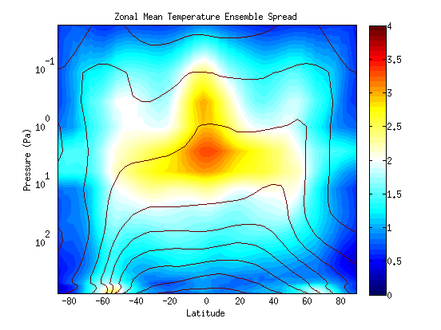
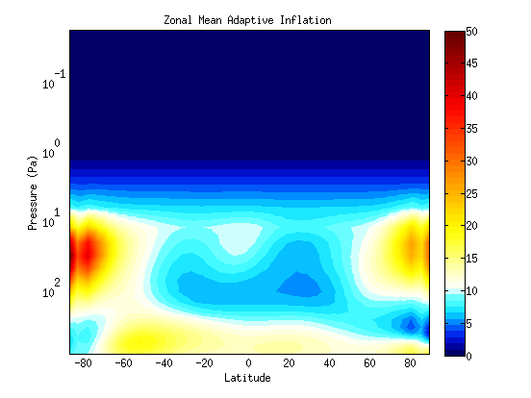
Regions of Chaotic and Stable Dynamical Error Growth:
Implications for Ensemble Spread, Inflation
Fixed Dust, Fixed Inflation
Fixed Dust, Adaptive Inflation
Temperature Bred Vector (Fixed Dust)
4 K
No Observations, No Inflation
Pseudo-Pressure (hPa)
2 K
0 K
Varying Dust, Fixed Inflation
Varying Dust, Adaptive Inflation
Estimated Inflation (Varying Dust)
50 %
No Observations, No Inflation
Pseudo-Pressure (hPa)
10 %
0 %
Latitude
Latitude
Latitude
Contours: Temperature Ensemble Mean; Shaded: Temperature Ensemble Spread, Bred Vector, or Inflation

Slide 17
Ensemble Spread Evolution
At a given model grid point and time t we can write:
Analysis Step: σ_{a}(t) = σ_{b}(t) • i(t-1) • r(t)
Forecast Step: σ_{b}(t+1) = σ_{a} (t) • g_{m}(t)
r(t) : the reduction in spread due to observations increasing our knowledge of the state r = (1 – K H)^{0.5}
i(t) : the (post-)inflation at time step t
g_{m}(t) : the change in ensemble spread due to the growth, decay, or advection of dynamical instabilities in the model from time t to time t+1

Slide 18
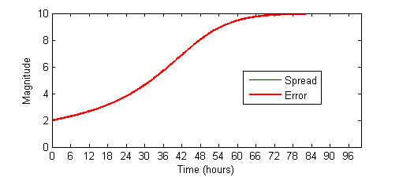
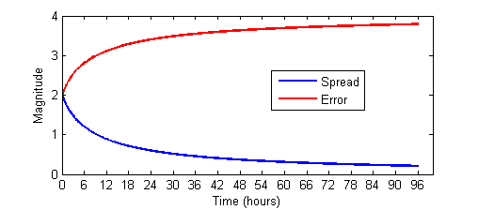
Sources of Forecasting Error
Dynamical Instabilities / Chaos
Model Error / Forcing
Small differences in initial conditions between two similar states grow until the error saturates and they are no different than two random states from climatology.
Model errors have both random and systematic components.
In a forced system, spread decreases over time as states are forced to converge.
If the model attractor differs from the real attractor, error will instead grow until it saturates at the difference in forcing.

Slide 19
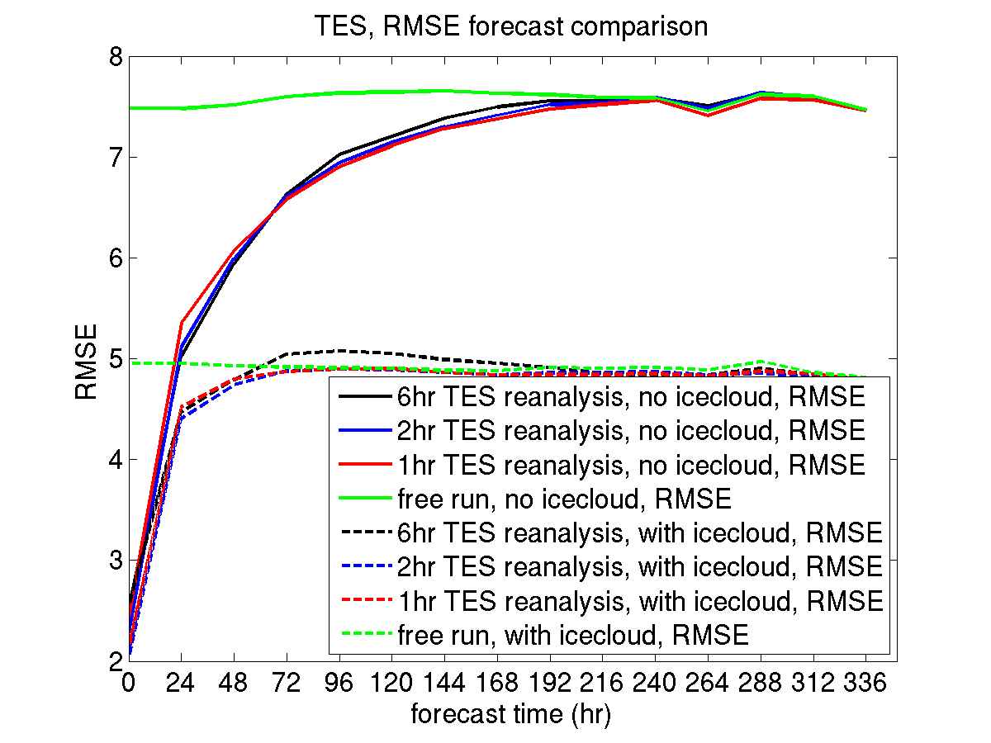
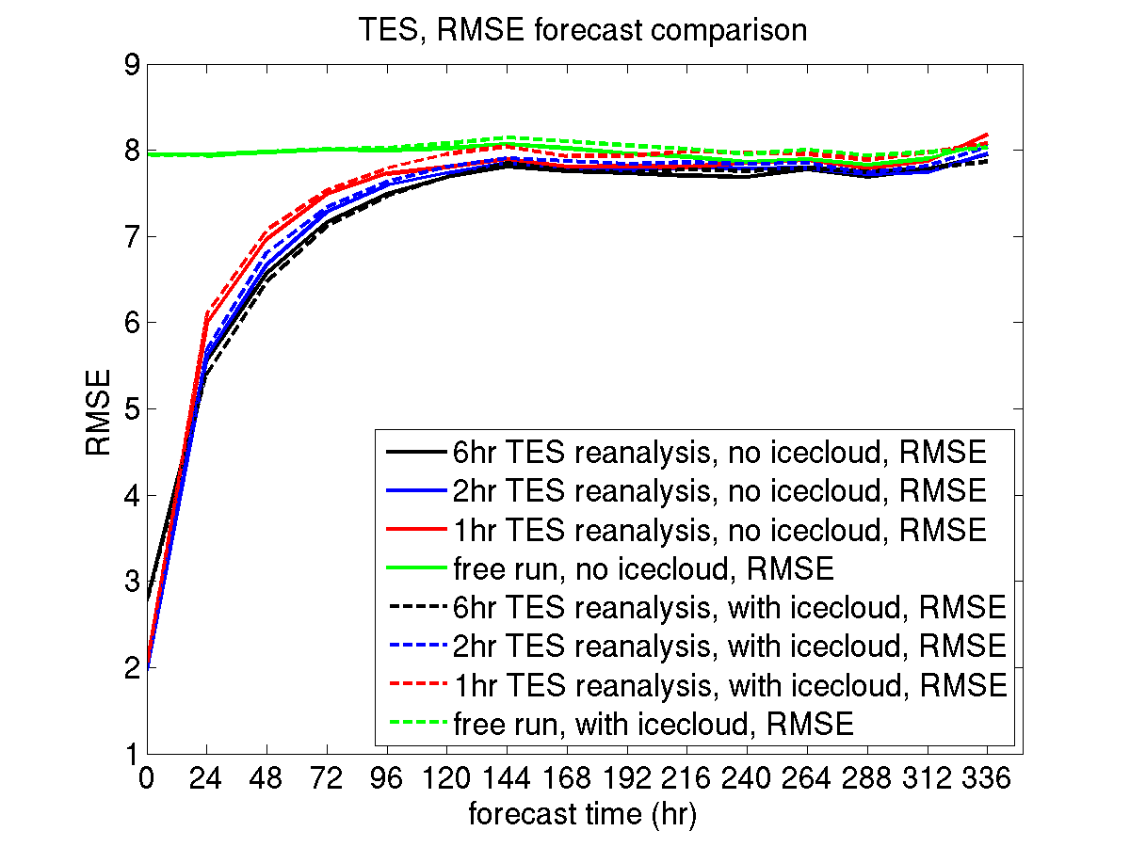
Courtesy of Grad Student Yongjing Zhao
Forecast Skill on Mars
NH Summer
NH Autumn

Slide 20
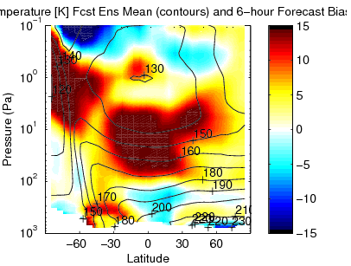
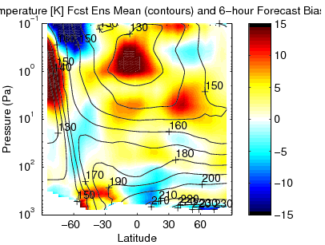
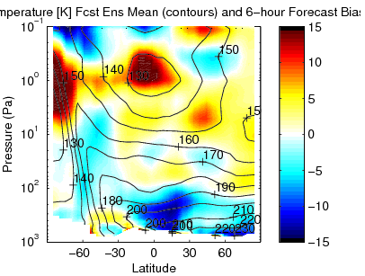
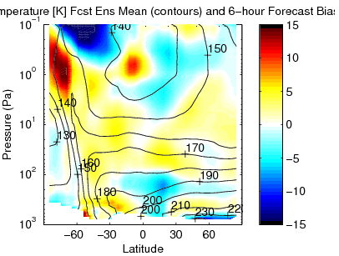
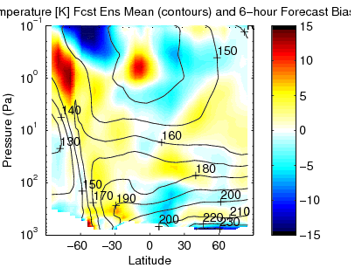
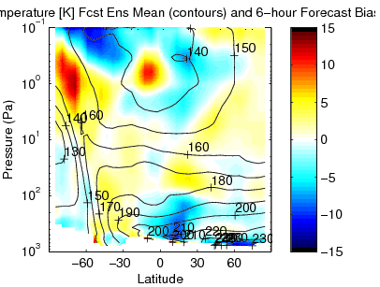
Improving Aerosol Representation
MCS Free Runs: Observation minus Model Bias
Seasonal Dust, No Ice Cloud
Seasonal Dust + Ice Cloud
3 Tracers + Ice Cloud
MCS Assimilation: Observation minus Model Bias
Seasonal Dust, No Ice Cloud
Seasonal Dust + Ice Cloud
3 Tracers + Ice Cloud

Slide 21
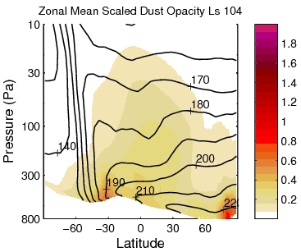
MGCM vs. MCS Aerosol
Opacities Normalized to 610 Pa
MGCM Forecast Aerosol
MCS Retrieved Aerosol
Challenges for GCMS:
Mars GCMS do not yet handle detached dust layer very well.
Dust lifting is also difficult to determine due to observation limitations and finite surface dust reservoirs.

Slide 22
Mars Climate Database 5 Dust Visible Column Opacity Courtesy of Luca Montabone
TES Begins
MY 24
MCS Begins
2001 Global Dust Storm
MY 25
MY 28
MY 26
MY 29
TES Ends
MY 27
MY 30

Slide 23
Strategies for Analyzing Aerosol
Greybush et al.
Oxford Mars Workshop
Constrain vertical distribution:
From aerosol vertical profiles.
From temperature fields.
Constrain column opacity:
From brightness temperature fields.
From column opacity products.
Estimate model / assimilation parameters:
Distribution of increment among tracer sizes.
Ice cloud radiative scaling factor.

Slide 24
Features of Martian Weather
Inform Assimilation System Design
Figure Courtesy of NASA/JPL and Malin Space Science
Diurnal Cycle, Thermal Tides, Topography
Traveling Weather Systems
Water Ice Clouds
Seasonal CO₂ Polar Ice Caps
Dust Devils, Regional and Global Storms
Optimal Window Length and Inflation
Localization Scales, Verification Metrics
Tuning Model Physics, Model Error
Enforcing CO₂ Conservation
Representing Aerosols in Ensemble
MGS Mars Orbital Camera (MOC) Visible Image
Notes:
Are those clouds associated with orography?

Slide 25
Features of Martian Weather
Inform Assimilation System Design
And Motivate Science Questions
Figure Courtesy of NASA/JPL and Malin Space Science
Diurnal Cycle, Thermal Tides, Topography
Traveling Weather Systems
Water Ice Clouds
Seasonal CO₂ Polar Ice Caps
Dust Devils, Regional and Global Storms
Optimal Window Length and Inflation
Localization Scales, Verification Metrics
Tuning Model Physics
Enforcing CO₂ Conservation
Representing Aerosols in Ensemble
What is the predictability horizon for Mars weather forecasting?
What instabilities give rise to forecast errors and changes in wave regimes?
How well are tides and traveling weather systems depicted in reanalyses, and can they be linked to dust lifting?
What is the spatial distribution and time evolution of ice and dust aerosol?
What mechanisms are responsible for global dust storm formation?
Notes:
Are those clouds associated with orography?

Slide 26
Lessons Learned on Mars
We have successfully created a multiannual reanalysis for Mars.
Need to validate system using several metrics designed to evaluate each aspect of Mars weather.
Observation increments must respect physical balances of the dynamical system: be careful of resonant tidal modes.
Address model bias: empirical bias correction, or by improving aerosol.
Address model error / spread: adaptive inflation, variability in aerosol and physics.
Next steps: atmosphere and aerosol analysis.

Slide 27
Lake Effect Snow: Assimilation and Prediction with WRF-EnKF
OWLeS: Ontario Winter Lake-effect Systems (LeS)
December 2013-January 2014
Mission Statement from http://www.owles.org/:
The OWLeS project examines the formation mechanisms, cloud microphysics, boundary layer processes and dynamics of lake-effect systems (LeS) at unprecedented detail using X-band and S-band dual-polarization (dual-pol) radars, an aircraft instrumented with particle probes and profiling cloud radar and lidar, a mobile integrated sounding system, a network of radiosondes, and a surface network of snow characterization instruments.
Lake-effect systems form through surface-air interactions as a cold air mass is advected over relatively warm (at least partially) ice-free mesoscale bodies of water. The OWLeS project focuses on Lake Ontario because of its size and orientation, the frequency of LeS events (especially intense single bands), its nearby moderate orography, the impact of Lake Ontario LeS hazards in particular on public safety and commerce, and the proximity of several universities with large atmospheric science programs.

Slide 28
Lake Effect Snow: Formation Factors
Instability driven by difference in temperature from lake surface to atmosphere during strong cold air advection.
Heat and moisture fluxes from lake depend on ice cover.
Wind direction and shear, as well as lake orientation / fetch determine type of convection.
Topography enhances snowfall.
Multiscale problem: synoptic setup, mesoscale details.

Slide 29
Lake Effect Experiment Design
Current | Planned
27 / 9 / 3 km domain | 9 / 3 / 1 km domain
Assimilate conventional, mesonet observations | Also assimilate radar, field campaign observations.
Near real time forecast | Ensemble Reanalysis and Forecasts
IC/BC from GFS | IC/BC from GEFS
Case Studies | Dec 2013 – Jan 2014

Slide 30
Preliminary Results: Dec 11 2013 Lake Effect Event
Comparisons are also underway with independent field campaign observations, including sondes and aircraft in situ data.

Slide 31
Scale | Window Length | Predictability
Oceans | Hours to Days | months
Synoptic Scale | 6-12 hours | 2 weeks
Mars | 1, 6 hours | Days
Mesoscale | ~ 1 Hour | Hours to days
Lake Effect | 1 hour | Hours to days
Storm Scale | Minutes | Minutes to hours

